Slide 1
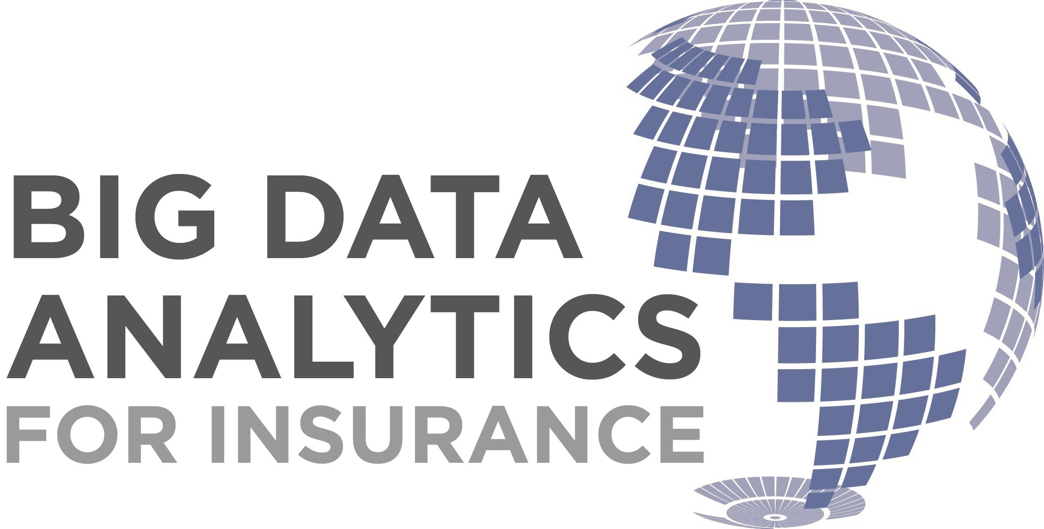
BY
PAVANI JAGARLAMUDI

Slide 2
CONTENTS
CHALLENGES IN INSURANCE
WHY BIGDATA FOR INSURANCE
USES OF BIGDATA IN INSURANCE
HOW WILL INSURERS USE BIGDATA
INSURANCE STARTUPS
FUTURE WORK
CONCLUSION
REFERENCES

Slide 3
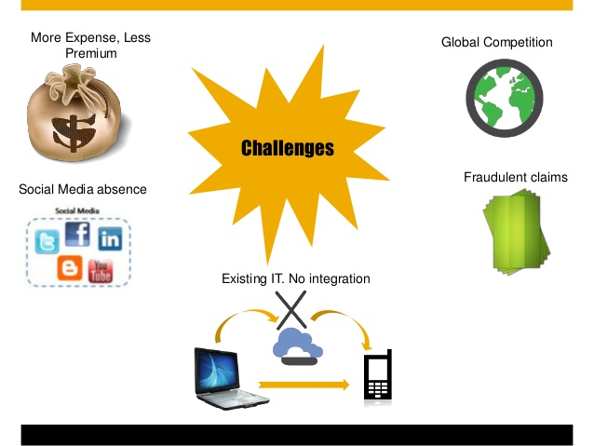

Slide 4
WHY BIGDATA FOR INSURANCE
The insurance industry is founded on estimating future events and measuring the risk or value of these events.
Big Data technologies are used comprehensively to determine risk, claims and enhance customer experience, allowing insurance companies to achieve higher predictive accuracy.
With new data sources such as telematics, sensors, government, customer interactions and social media, the opportunity to utilize big data is more appealing across new areas of this industry nowadays.

Slide 5
USES OF BIGDATA IN INSURANCE INDUSTRY
RISK ASSESSMENT
Many insurers benefit from telematics, IoT devices and wearables to track their customers in order to predict and calculate risks.
By using predictive modeling, the insurers can identify whether the drivers are likely to be involved in an accident, or have their car stolen, by combining their behavioral data with the factors such as road conditions or safe neighborhoods.

Slide 6
USES OF BIGDATA IN INSURANCE INDUSTRY
2. FRAUD DETECTION
Insurers use Big Data to improve fraud detection and criminal activity through data management and predictive modeling.
These matches could also involve the behavior of the person making a claim, the network of people that associate with (social media, credit reference agencies etc.) and partner agencies involved in the claim (e.g. vehicle repair shops).

Slide 7
USES OF BIGDATA IN INSURANCE INDUSTRY
3. CUSTOMER INSIGHTS
Information gained from call center data, customer e-mails, social media, user forums and user behavior while logged into the insurers sites enable insurers to build unique customer profile.
Gaining customer insight with big data analytics not only provides predictions about when a customer is likely to leave, or shapes a customer’s policy.
It can also help insurers to develop trusted relationships and engage customers in the right way with the accurate information.
As a result of this strategic learning, insurers achieve positive outcomes such as solving customer problems real-time with the right approach.

Slide 8
USES OF BIGDATA IN INSURANCE INDUSTRY
4. MARKETING
After gaining a full understanding of customer behavior, insurance companies became more efficient in offering targeted products and services.
This is done by offering personalized services and products such as lower priced premiums, contacting the customer for special offers when they are likely to leave or even offering a family package when a family is likely to have a baby.

Slide 9
USES OF BIGDATA IN INSURANCE INDUSTRY
5. CUSTOMER EXPERIENCE
Insurers now build personalized offers to their customers based on their preferences and behavioral data as well as offering them innovative services that streamline the purchase process.
Especially health insurance companies utilize apps and wearables data enabling them to proactively track their customers, while helping the customers to manage their health conditions/ chronic diseases.
P&C insurers also enhance their customer experience by assisting them to improve safety. Driver Feedback app, evaluates customers driving behaviors and shares tips to improve their driving habits.

Slide 10
USES OF BIGDATA IN INSURANCE INDUSTRY
6. AUTOMATION
Insurers used to automate simple processes such as compliance checks, data entry, or repetitive tasks that require less-initiative taking skills.
With a move towards more intelligent automation, insurers can save a vast amount of time and money with the help of machine learning which trains data to improve algorithms and of course predictive analysis.

Slide 11
USES OF BIGDATA IN INSURANCE INDUSTRY
7. SMART LABOR & FINANCE
With the help of real-time analysis, insurers now can make daily adjustments to premium rates, premium strategies and underwriting limits by combining internal data (policy, regulations) with external data (social media, press, analyst comments) in order to optimize their finances and instant payouts.
Data mining techniques are also used to cluster and score claims in order to prioritize and assign them to the most appropriate employee based on their experience on claim complexity.
This saves insurers a significant amount of labor-time and prevents them from high settlement amounts.

Slide 12
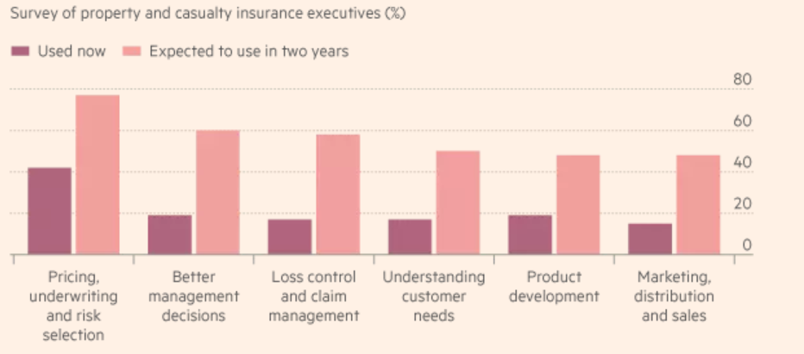
HOW WILL INSURERS USE BIGDATA

Slide 13
INSURANCE STARTUPS
Oscar Health Insurance, currently available only in New York.
It uses bigdata, modern apps and web interfaces, enabling customers to get real-time information on which doctors and medicines are available to them in their area and to have a 360 view on each customer.
MetroMile offers “pay as you go” car insurance, drivers pay by mile.
A device tracks mileage and customers are billed monthly according to how far they have driven.
The company claims that this saves low-mileage drivers an average of $500 a year.

Slide 14
CONCLUSION
Thus Big data is undoubtedly a tool that brings positive outcomes such as enhanced customer experience, innovative products and better risk management leading the insurance industry to make better strategic decisions.

Slide 15
FUTURE WORK
Ability to adjust their business model fast to new trends.
Improved financial reporting and control systems.
Enhanced data security systems and tools.
Predictive analytics and modelling methods tools to manage, synthesize, analyze and leverage massive data volumes.
Stronger digital capabilities complemented by new skills, refined metrics, upgraded tools and an innovation culture.

Slide 16
REFERENCES
https://www.simplilearn.com/big-data-applications-in-industries-article
https://www.forbes.com/sites/bernardmarr/2015/12/16/how-big-data-is-changing-the-insurance-industry-forever/#c879990289bd
https://www.ft.com/content/3273a7d4-00d2-11e6-99cb-83242733f755
https://www.exastax.com/big-data/top-7-big-data-use-cases-in-insurance-industry/
https://blogs.sap.com/2017/08/08/predictive-analytics-impact-on-the-insurance-industry/
https://www.soa.org/files/pdf/research-pred-mod-life-batty.pdf
http://www-935.ibm.com/services/uk/en/attachments/pdf/IBM_BAO_Big_Data_Insurance_WEB.pdf
https://www.slideshare.net/EuroITGroup/insurance-big-data-slideshare
https://www.slideshare.net/stuartdrose/sas-customer-analytics-for-insurance-16262864
https://www.slideshare.net/shaliniajay/insuralytics-high-fidelity-prototype

